Slide 1
USAF Officer Performance Evaluations
Lowering the Higher Level Reviewer for CGOs
and CY23 Stratification Policy Change Review
HAF/A1P
June 2024

Slide 2
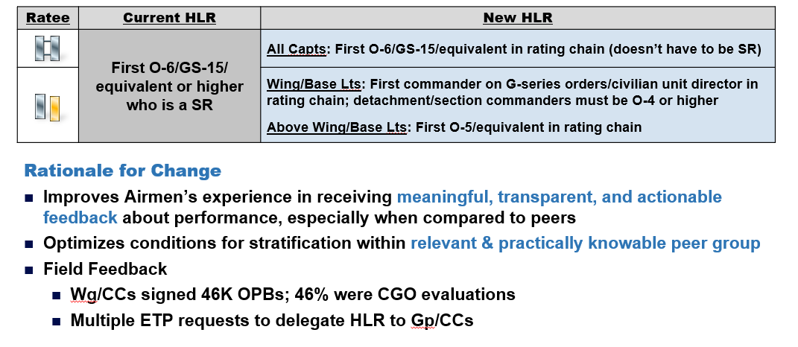
Lowering the HLR for CGO Evaluations

Slide 3
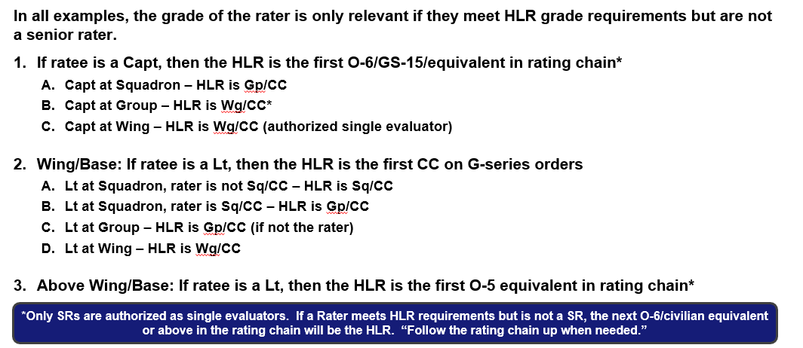
HLR Examples

Slide 4
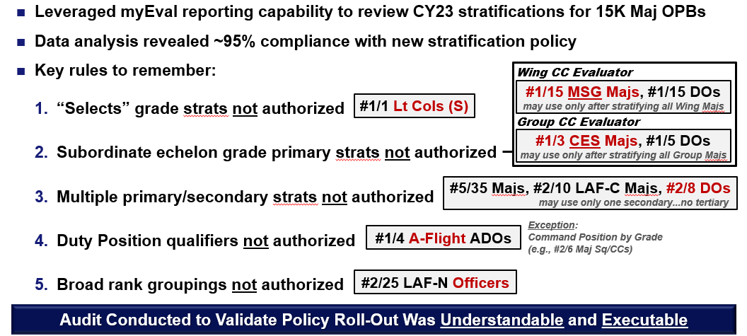
CY23 AF Officer Stratification Review
Notes:
Officers must first earn Primary Stratification to unlock Secondary Stratification
Primary = Grade
Secondary = DevCat Grade, AF/SF Grade, Subordinate Echelon Grade, Duty Position, AFR/ANG Component
Two exceptions:
1. RegAF Promotion “Selects” only authorized Secondary
2. When Ratee/Rater same grade, then HLRs may opt to skip to Secondary
A1 audit of 15K Maj SCOD OPBs conducted not to “police strats”; rather, to determine if new policy was understandable and executable (95% compliance appears to indicate “yes”)
A1 is not the police, but addressing the non-compliant 5% improves reliability of HLR signature for centralized talent management processes; establishes level playing field for officers meeting same boards
Analysis reveals ~95% compliance with stratification policy; slide highlights trends for most common errors
New stratification policy improves reliability and equitability of future unit-level and enterprise-level talent management decisions

Slide 5
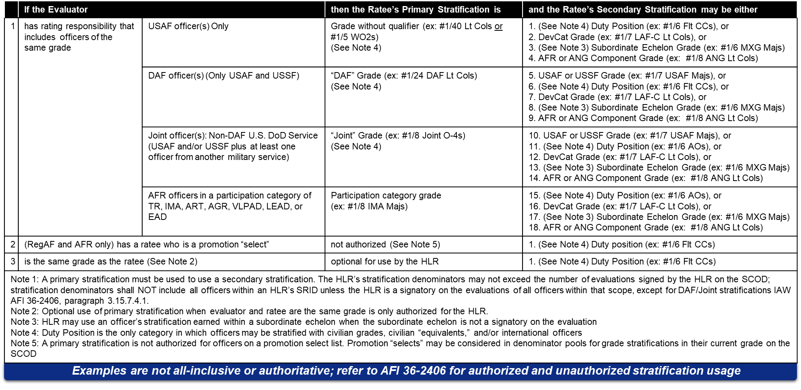
Deskside Quick-Reference USAF Authorized Stratification(s) Table
CAO 1 April 2024

